Slide 1

DevOps - IBM Rational Tools

Slide 2
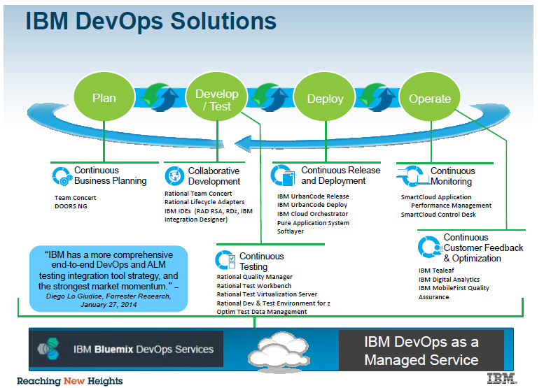

Slide 3

ADOPT: Reference Architecture
(IBM & Open Source Tools)
Continuous Planning
CI & Build Management
Continuous Testing & SV
Release & Deployment Automation
Continuous Monitoring & Feedback
Integrated Portal
Reports & Dashboard
Administration
User Management
Collaboration / Document Management / Wiki (Confluence)
Jazz Engine
CLM Platform
DOORS Next Generation, RSA
Rational Team Concert
Rational Quality Manager
UCDeploy, UCRelease
Rational Reporting for Development Intelligence
Orchestration(Jenkins)
Integration
Platform
Build Automation (Maven, ANT)
Service Virtualization(RTV)
CMDB: Infrastructure as code(uDeployPattern)
Application & Infrastructure Monitoring(Tivoli)
Code Quality (Rational Software Analyzer)
Vulnerability Assessment (AppScan)
Environment Provisioning Automation (uDeploy)
Log-Analysis / Log Aggregation (Tivoli)
Functional Platform
Artifact repository (Nexus)
Capacity Management(Tivoli)
Service Management(Tivoli)
Open Source Tools

Slide 4
What is Collaborative Lifecycle Management (CLM)?
Rational solution for Collaborative Lifecycle Management (CLM) is an integrated Application Lifecycle Management solution.
The rational solution for CLM is built on Jazz server and helps teams integrate tasks across the software lifecycle.
CLM provides integrations across various Jazz-based applications such as Requirements Management (RM), hence providing a means to connecting the work of analyst with development and test teams.

Slide 5
CLM Applications and Capabilities
Change and Configuration Management (CCM)
CCM provides capabilities for Change Management (work items), Software Configuration Management, Planning and automation build.
Requirement Management (RM)
RM provides capabilities for capturing, managing and tracing requirements through out the project lifecycle.
Quality Management (QM)
QM provides capabilities for test management that includes test planning, creation and execution.
Design Management (DM)
DM provides capabilities for in-context collaboration, traceability and impact analysis, agile sketching and domain modeling.

Slide 6
Rational Team Concert
Iteration Planning
Integrated iteration planning and execution
Task estimation linked to key milestones
Out of the box agile process templates
Project Transparency
Customizable web based dashboards
Real time metrics and reports
Project milestone tracking and status
SCM
Work Items
Build
Integrated stream management with flow relationships
Component level baselines
Server-based sandboxes
Identifies component in streams and available baselines
ClearCase connector
Defects, enhancements and conversations
Query results view and share queries with team or member
Support for approvals and discussions
ClearQuest connector
Query editor interface
Work item and change set traceability
Local or remote build servers
Supports ant and command line tools
Integration with build forge
Build definitions for team and private builds
Jazz Team Server
Single structure for project related artifacts
World-class team on-boarding / offboarding including team membership, sub-teams and project inheritance
Role-based operational control for flexible definition of process and capabilities
Team advisor for defining / refining “rules” and enabling continuous improvement
Process enactment and enforcement
In-context collaboration shows team members and status of their work
6

Slide 7
Udeploy
IBM UrbanCode deploy orchestrates and automates the deployment & rollback of applications, databases and configurations into DTAP environments which helps to cut down the cost and time to market with reduced risk.
Key Features & benefits
Multi-Tier Application Models: Three tier application with DB, App & Web etc.
Scalable Distributed Automation: Support mission-critical deployments to thousands of servers in numerous data centers.
Track What is Where : The Inventory system tracks the desired state of each environment.
Quality Gates and Approvals: Help you ensure that only the right stuff goes out at the right time
Continuous Delivery: Integrate with build and test tools to automatically deploy, test and promote new builds.
Facilitates the integration with different tools via plugins.
Incremental Updates: Patch upgrade, config management etc
Easy Process Designer: Automated deployment processes using the graphical editor, Drag & Drop Work Flows.

Slide 8
Collaborative release planning includes a full set of capabilities designed to reduce the time spent in release planning meetings and reviews. Environment management makes it easier to allocate environments to the development and testing phases in a release, providing better visibility and control. Streamlined release execution provides processes to facilitate release tracking, email notifications and automatic promotion to early environments. Integration capabilities enable interfaces with IBM Rational Team Concert™ and IBM UrbanCode Deploy.
UrbanCode Release features

Slide 9
RRDI Capabilities
Users of all three CLM products (IBM Rational Team Concert, IBM Rational Quality Manager, and IBM Rational Requirements Composer) can access RRDI.
CLM reports implemented in RRDI include the following examples:
Test coverage of requirements
Development item coverage of requirements
Requirements affected by defects
Requirements Test Execution results
Requirements Lifecycle Traceability report

Slide 10
Rational Test Workbench
RTW provides a comprehensive test automation solution for all type of applications, regression testing, integration technologies and performance and scalability testing.
Simplifies test creation with Story Board testing and code-free test authoring.
Quickly develop complex performance test scenarios with script-less, visual, performance test and workload models.
Provides earlier, end-to-end continuous integration testing throughout hardware, software and cloud-based dependencies.
Emulates workloads accurately so you can create a server workload that represents realistic user scenarios.
Is extensible and supports standards and protocols to help you meet the challenges of your testing environment

Slide 11
IBM Rational Tools Mapping
SDLC Process Area | Tools Mapping
Requirement Capturing | Rational DOORS Next Generation
Design | Design Management
Code, Build & Defect | Change & Configuration Management
Defects Tracking, Allocation, Test cases | Quality Management
Build Automation | Rational Team Concert
Deployment | uDeploy
Release Planning | uRelease
Testing | Rational Test Work Bench
Report | RRDI – Rational Reporting for Development Intelligence

Slide 12
Rational Tools : User perspective
Executives
Release Manager
Reporting & Dashboard
Systems/Component sprint level commitments w.r.t the releases
Release & Sprint level commitments per system/component level
Over all status of Design/Dev/Testing/Defects progress of Past/Present/Future release
Build & Deployment status
Release , Reporting & Dashboard
Create & Map releases with up & down stream components
Sprint level commitments per system/component level
Number of stories are tagged specific to the system/component
System / Component wise overall progress(%) w.r.t the releases
RRDI
uRelease & RRDI
Project Manager
BA & Design Team
Planning, Tracking, Tasks Creation,
Reporting & Dashboard
Systems/Component sprint level commitments w.r.t the releases
Release & Sprint level commitments per system/component level
Allocating & Tracking development tasks, defects per system / component level to the individual team member level
Build & Deployment status
CCM
& RRDI
Req. Capturing &
Design
Capturing requirements, create design document
Mapping of requirements with design cases w.r.t Systems / Components
Can draw diagrams(Ex., Use case, Sequence, State flow diagrams)
Can bring the traceability of solution stories to component level
Assign design doc to dev team members
RSA
Development Team
Build & Deployment Team
Code Dev,
Build,
Reporting & Dashboard
Integrate Eclipse plugin to write code
Configure build tools to pack the complete modules
Configure with application server
Can view the allocated tasks, Target dates of assigned system/component & its development schedule w.r.t planned start/end dates
Build &
Deploy
Authorized to view all the releases which he/she handles
Can view the Systems/Components which are mapped to the releases
System/Component wise build & deployment status on daily level
Number of pass/fail build & deployment status per System/Component wise
RTC,CCM
& RRDI
RTC & uDeploy
QA &
Testing
Authorized to view all the releases which he/she handles Test Case Creation & Data Mgmt
Can view the Systems/Components which are mapped to the releases Functional Testing
System/Component wise test cases & scenarios status Performance Testing
Assign defects; View number of defects per System/Component wise
RQM, RFT & RPT

